Slide 1


Info Gain
N170874
N170985
N171080
N170448
N170468

Slide 2
Abstract
Our project mainly deals with information gathering about website.
Finding Open Ports of the website that are open.
Finding DNS information about the website.
Finding Subdomains of the website.
Finding WhoIs Lookup about that website.
Finding hidden directories of the website by bruteforce method.

Slide 3
About Info Gain
In Web Penetration or In Bug Bounty the first step is Information Gathering about the target i.e., Website. In order to make remaining steps effective we need to gather effective information about target. Information involves Open Ports list, DNS information, Whois lookup, Subdomain Enumeration. For each requirement there are respective tools available in internet for use, but user should have to visit to different websites and have to install different software’s or have to download many scripts and run that are available in GitHub, user have to switch to websites, scripts, tools according to feature. There is no tool so that all these requirements are fulfilled at one place without switching. So, we have developed a project i.e Infogain, in which user can get all type of information about the target at once, then it will save his time to focus on remaining steps in web penetration or bug bounty to get effective results.

Slide 4
Information Gathering
Information Gathering means gathering different kinds of information about the target. It is basically, the first step or the beginning stage of Ethical Hacking, where the penetration testers or hackers (both black hat or white hat) tries to gather all the information about the target, in order to use it for Hacking. To obtain more relevant results, we have to gather more information about the target to increase the probability of a successful attack.
Information gathering is an art that every penetration-tester (pen-tester) and hacker should master for a better experience in penetration testing

Slide 5
Motivation for InfoGain
There are many tools available in github and there are many websites(paid and unpaid) to gather information about the website.
But for each feature we need to switch everytime to many websites, install many tools(scripts).But there is no tool that all these features are available in one.For switching it takes time.Even it is available there is no GUI.
So that thought motivated us to develop this tool and introduce it in GUI, to save user’s time and make the things simple, so he can invest more time in other steps.

Slide 6
Real World Applications
Can be used for information gathering about the website.
For Bug Bounty hunters, website penetration tester this tool will be very useful.
Very useful for the website developers to test their website,where it is prone to any confidential information leak,so they can rectify it.

Slide 7
Few related works and their limitations
Nmap for open port scanning and hidden directory brute force.
AMASS,SubBrute,Knock,Sublist3r for Subdomain enumeration.
Who.is, Name.com, Domaintoolws.com, GoDaddy.com for whois lookup
Dns-lookup github script for DNS Enumeration
But these all are developed tools are limited to only one feature.
We have to switch to many websites and many tools for respected features.

Slide 8
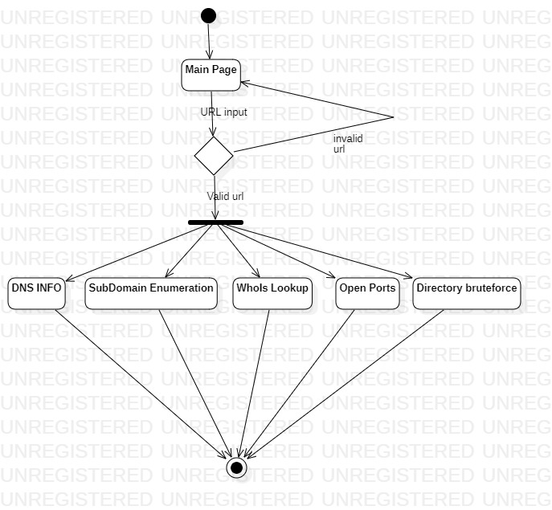
Flow Chart

Slide 9
WhoIs Lookup
A Whois record contains all of the contact information associated with the person, group, or company that registers a particular domain name. Typically, each Whois record will contain information such as the name and contact information of the Registrant (who owns the domain), the name and contact information of the registrar Registrar (the organization or commercial entity that registered the domain name), the registration dates, the name servers, the most recent update, and the expiration date. Whois records may also provide the administrative and technical contact information (which is often, but not always, the registrant).

Slide 10
Open Ports Enumeration
In networking, a protocol is a set of rules for formatting and processing data. Network protocols are like a common language for computers. The computers within a network may use vastly different software and hardware; however, the use of protocols enables them to communicate with each other regardless.
PORT SCANNING : There are 64k ports in a computer out of which 1k are fixed for system or OS services. In Port scanning we scan for the open Ports which can be used to attack the victim computer.
In Port scanning a series of messages sent to break into a computer to learn about the computer’s network services. Through this we will know that which port we will use to attack the victim
Open ports become dangerous when legitimate services are exploited through security vulnerabilities or malicious services are introduced to a system via malware or social engineering, cybercriminals can use these services in conjunction with open ports to gain unauthorized access to sensitive data

Slide 11
Sub Domain Enumeration
A domain name is a string of text that maps to a numeric IP address, used to access a website from client software. In plain English, a domain name is the text that a user types into a browser window to reach a particular website. For instance, the domain name for Google is ‘google.com’.
A subdomain is an additional part to your main domain name. Subdomains are created to organize and navigate to different sections of your website. You can create multiple subdomains or child domains on your main domain.
The most common use-case of a subdomain is for creating a testing or staging version of a website. Often developers will test new plugins and updates on a subdomain staging site before publishing them live on the Internet.

Slide 12
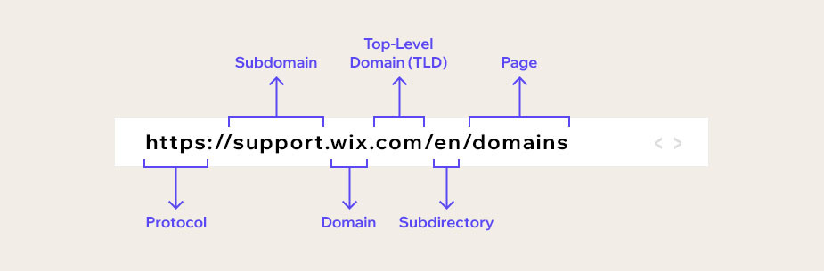

Slide 13
DNS ENUMERATION
The Domain Name System (DNS) is the phonebook of the Internet. When users type domain names such as ‘google.com’ or ‘nytimes.com’ into web browsers, DNS is responsible for finding the correct IP address for those sites. Browsers then use those addresses to communicate with origin servers or CDN edge servers to access website information. This all happens thanks to DNS servers: machines dedicated to answering DNS queries.
DNS enumeration is the process of locating all the DNS servers and their corresponding records for an organization. DNS enumeration will yield usernames, computer names, and IP addresses of potential target systems. The list of DNS record provides an overview of types of resource records (database records) stored in the zone files of the Domain Name System (DNS). The DNS implements a distributed, hierarchical, and redundant database for information associated with Internet domain names and addresses

Slide 14
DNS RECORDS
DNS records (aka zone files) are instructions that live in authoritative DNS servers and provide information about a domain including what IP address is associated with that domain and how to handle requests for that domain. These records consist of a series of text files written in what is known as DNS syntax. DNS syntax is just a string of characters used as commands that tell the DNS server what to do. All DNS records also have a ‘TTL’, which stands for time-to-live, and indicates how often a DNS server will refresh that record.
You can think of a set of DNS records like a business listing on Yelp. That listing will give you a bunch of useful information about a business such as their location, hours, services offered, etc. All domains are required to have at least a few essential DNS records for a user to be able to access their website using a domain name, and there are several optional records that serve additional purposes

Slide 15
Common DNS Records
A record - The record that holds the IP address of a domain.
AAAA record - The record that contains the IPv6 address for a domain (as opposed to A records, which list the IPv4 address).
CNAME record - Forwards one domain or subdomain to another domain, does NOT provide an IP address.
MX record - Directs mail to an email server.
TXT record - Lets an admin store text notes in the record. These records are often used for email security.
NS record - Stores the name server for a DNS entry.
SOA record - Stores admin information about a domain.
SRV record - Specifies a port for specific services.
PTR record - Provides a domain name in reverse-lookups.

Slide 16
DIRECTORY BRUTE FORCE
A directory is a location for storing files on your computer.
Directory brute force is used to find hidden and often forgotten directories on a site to try to compromise. Some various automated tools and scripts retrieve the status of the directory which is brute-forced from custom wordlists

Slide 17
Technologies/Libraries
Technologies: Python
Libraries: Tkinter(gui) , dns.(dns resolver), sys ,bs4 , requests, PIL socket , os, threading, time, re

Slide 18
Text Files
Wordlist.txt for directory bruteforce.
Names.txt for subdomain bruteforce.

Slide 19
System Hardware/System Software
Windows Operating system(Windows 7/8/8.1/10/11)
Minimum 1GB RAM
Minimum I2 Processor

Slide 20
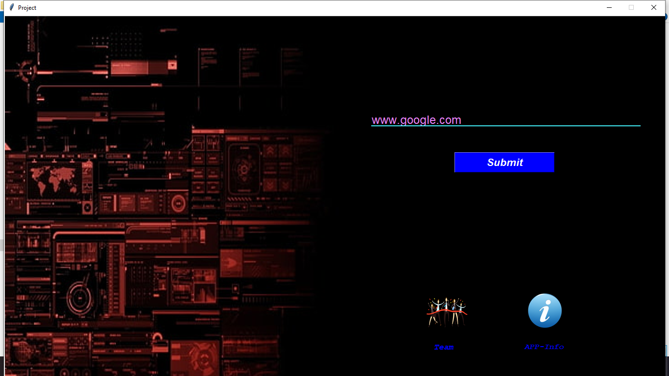
Screenshots

Slide 21
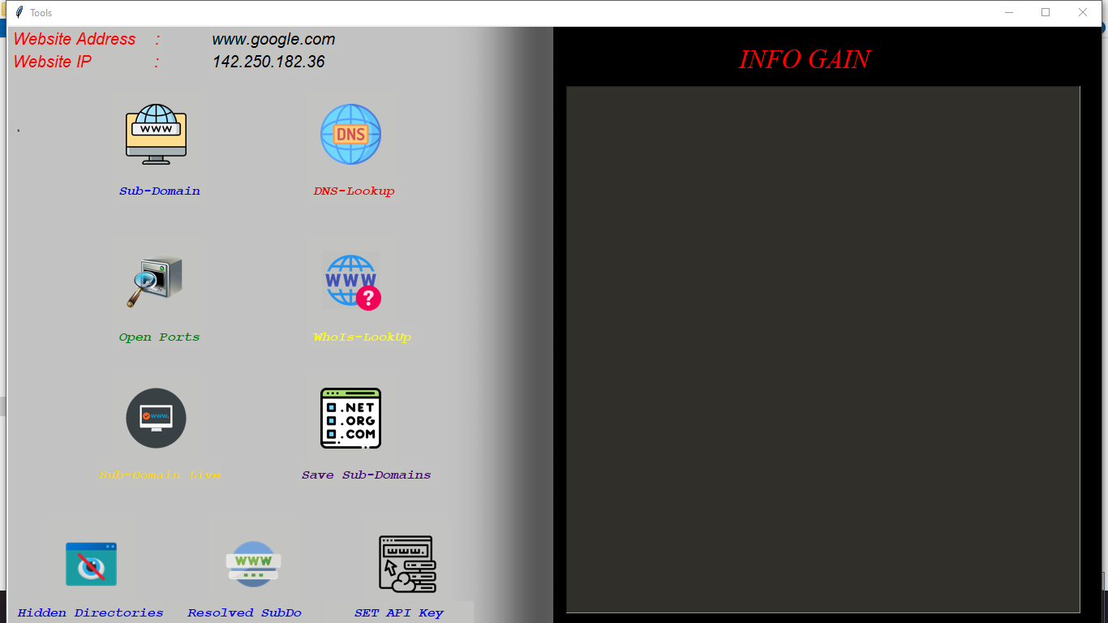

Slide 22
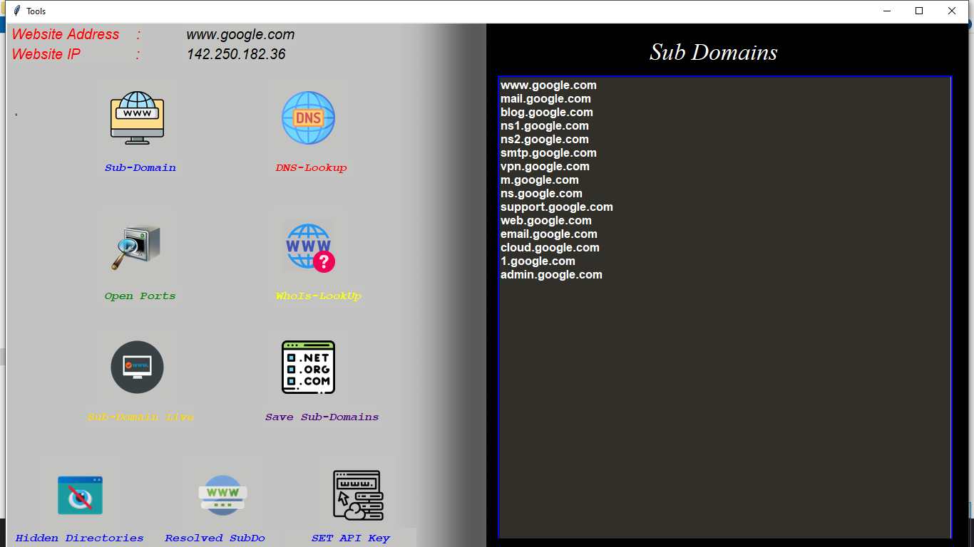

Slide 23
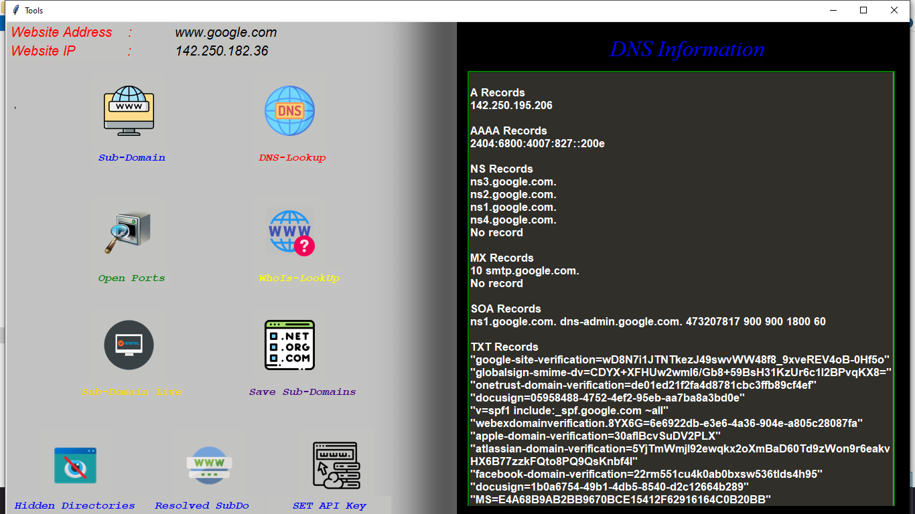

Slide 24
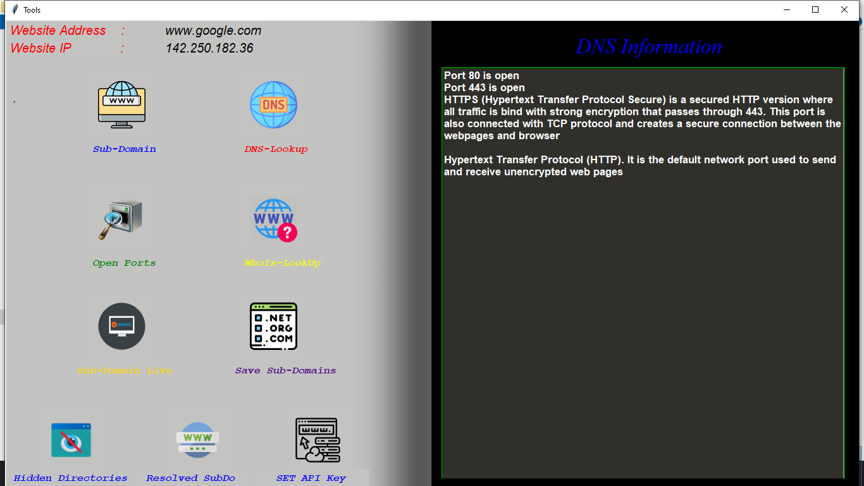

Slide 25
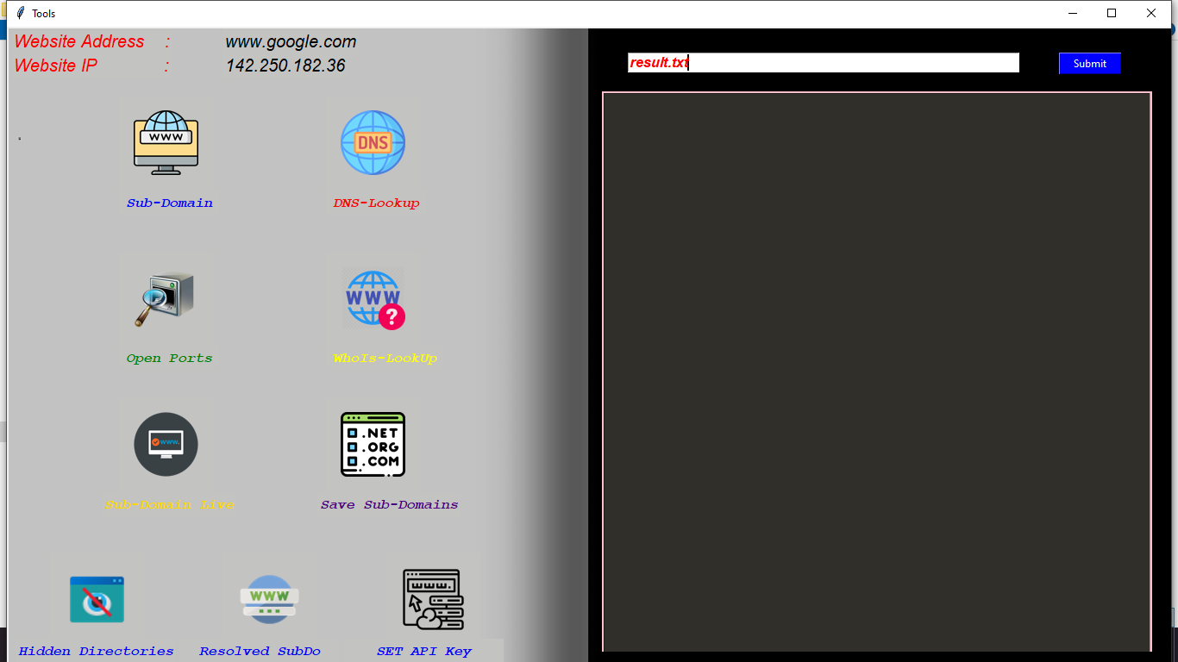

Slide 26
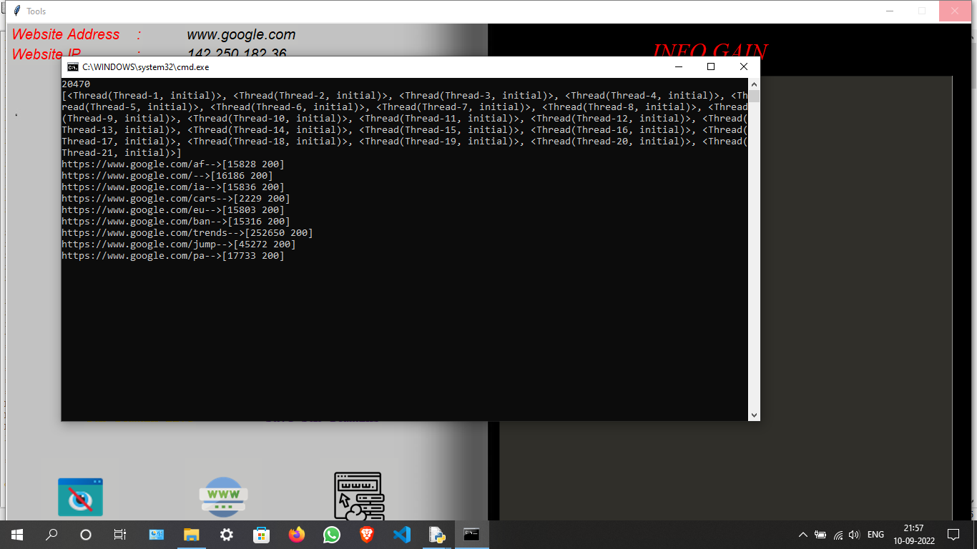

Slide 27
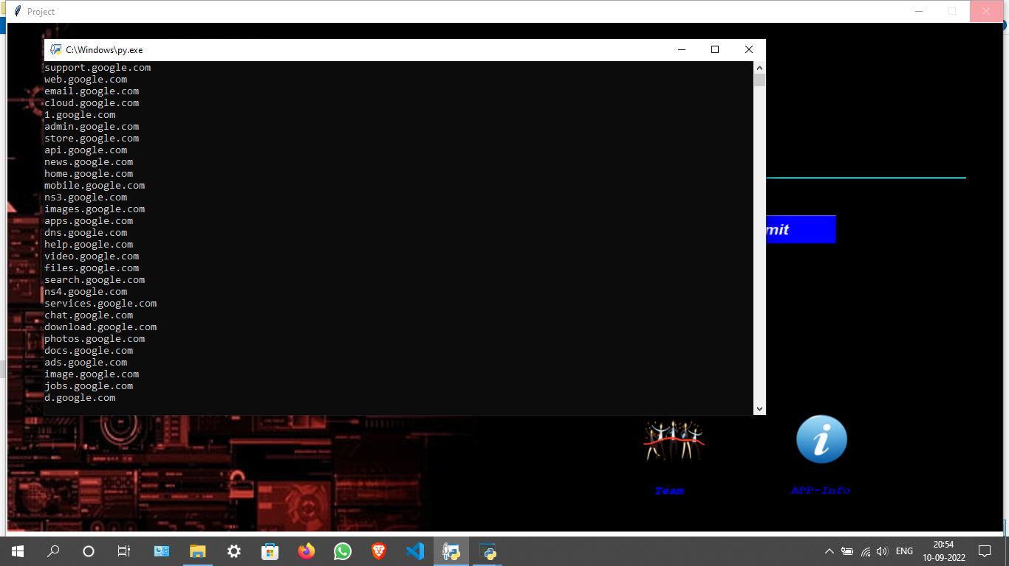

Slide 28
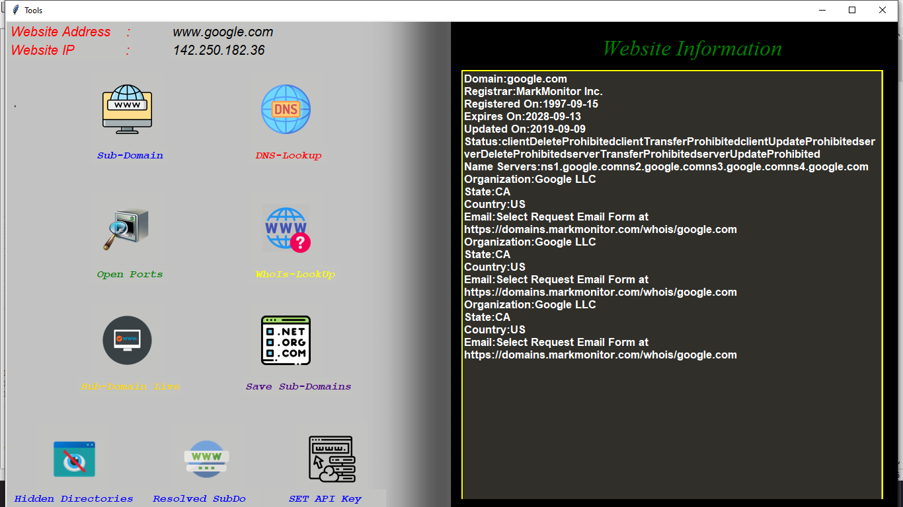

Slide 29
Conclusion
InfoGain saves user’s time by making available all features at one place.
GUI makes very easy for users to understand.

Slide 30
Future Scope
We can add many other features like other features like finding technologies on which the website built with.
We can add google map facility to locate that website server.
Using many other passive information gathering websites by applying webscrapping.
Finding the filtered ports along with open ports.

